Slide 1
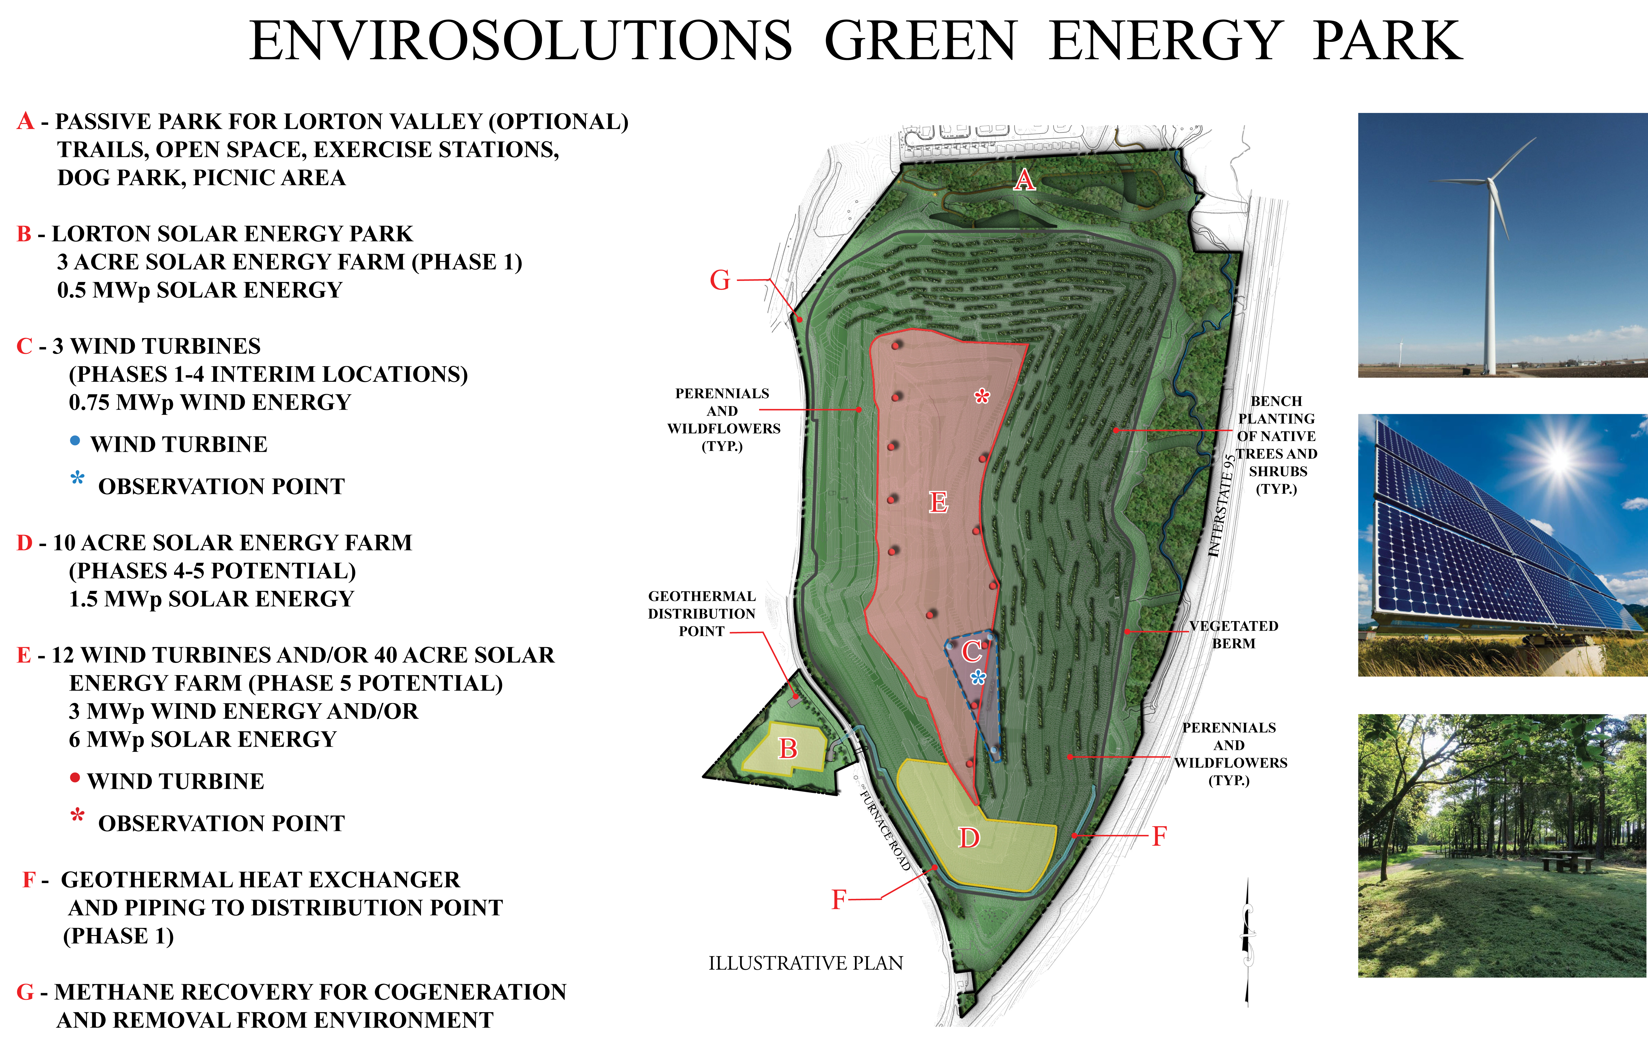
REVISED JUNE 2013
PROJECT # 05117

