Slide 1
8800 Richmond Highway Redevelopment
working together to redevelop and clean up the environment

Slide 2
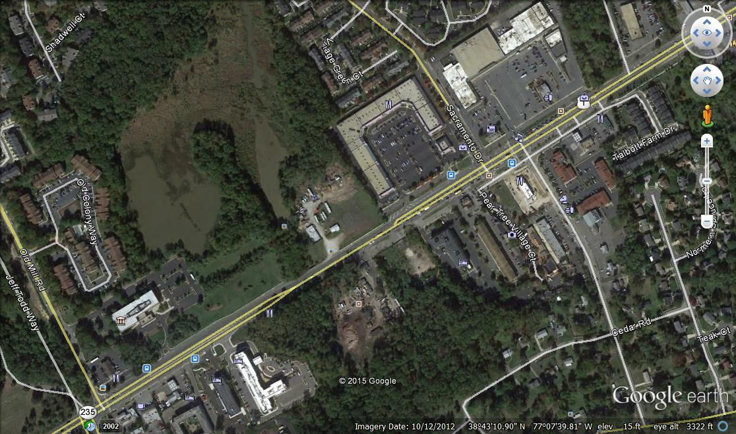
site area image IMP Bldg. to the SW and Sacramento Center to the NE, Park Authority pond to the North

Slide 3
Southern End of Richmond Highway
Little sense of community—this can change
No sense of place—destination— this can change
Woodlawn is next door—great opportunity
Lets build on to the Woodlawn Vibe
Create a place for families
Clean up the stream bed
Create a community focused front door to the Park Authority Pond area—with its diverse wildlife of birds and small mammals

Slide 4
MVCCA Asked for an out of turn amendment to add residential to this area
Gerry Hyland supports the MVCCA out of turn amendment to add a residential option to this part of the commercial zoned land on Richmond highway – this can be the first step
We propose to work with the staff to begin the process of changing the C-8 zoned site to residential in keeping with the MVCCA proposal
Staff has not moved forward with the Comp Plan amendment this will push the envelope

Slide 5
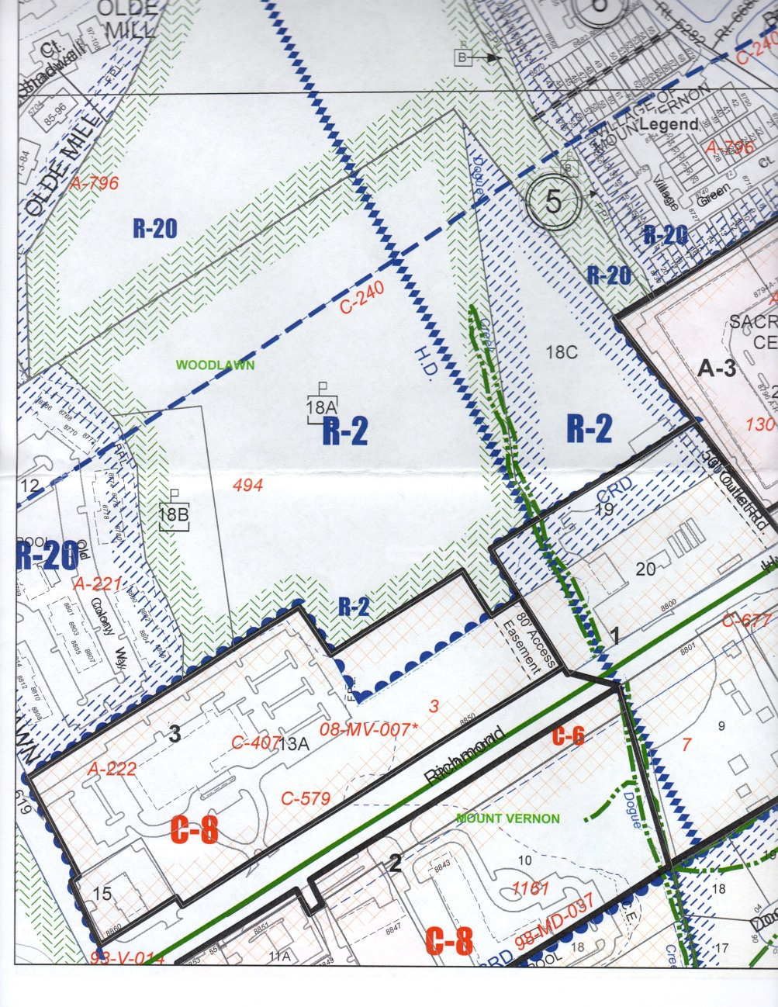
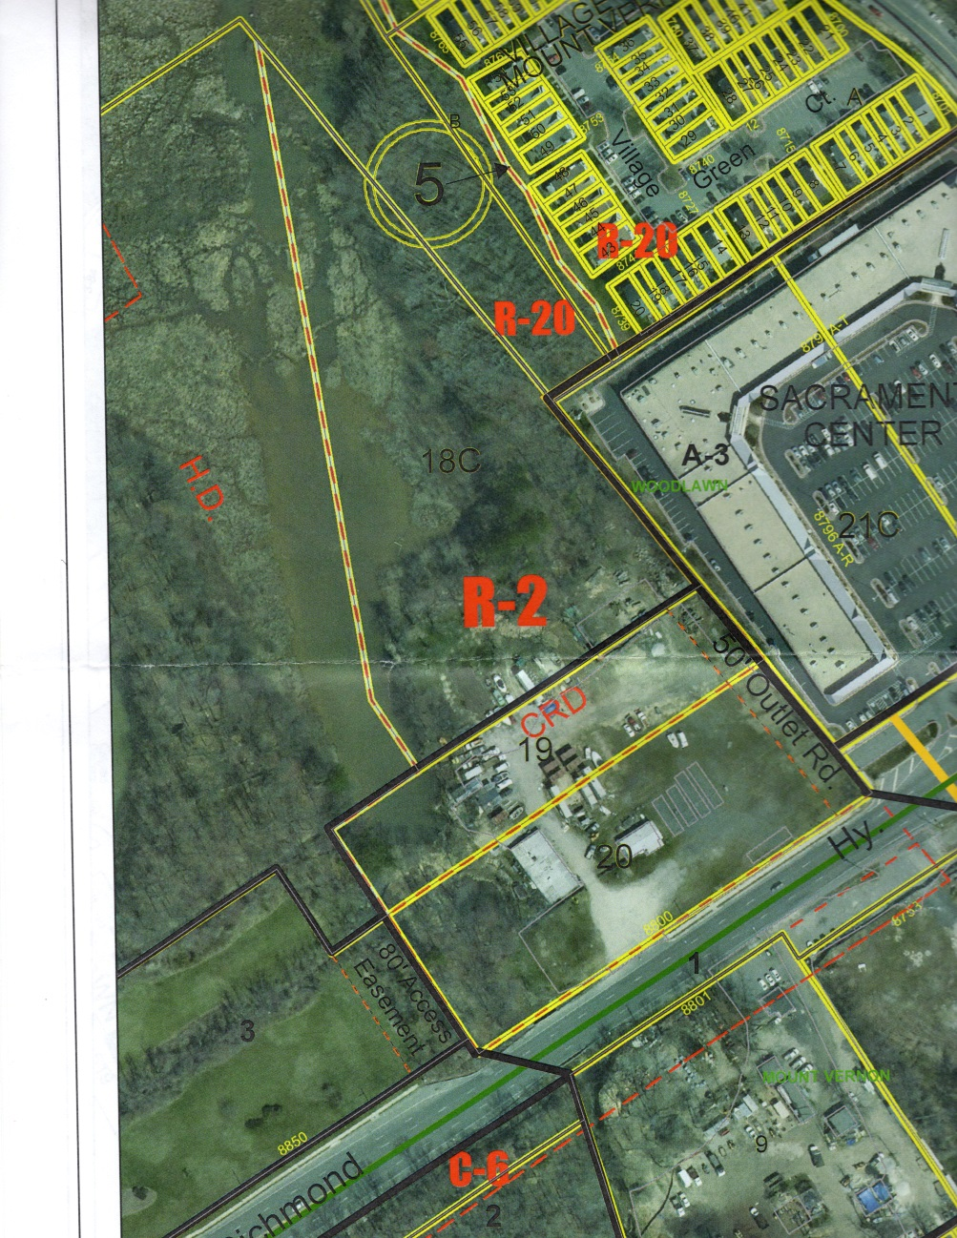
Site boundary; zoned C-8 and R-2 about 8 acres total

Slide 6
A Problem site that with the right approach has significant potential
Was an amusement park from 1947 until the late 1960’s—still owned by the same family
Was a spoil site for the state and county for Richmond Highway construction 1960’s
Has been in C-8 zoning and used as a contractors offices, shops and storage, repair facilities & etc since not appropriate land use and poor front door on Richmond Highway
The Family “gave” most of the small lake, Island and park area to the Park Authority in the 1960’s

Slide 7
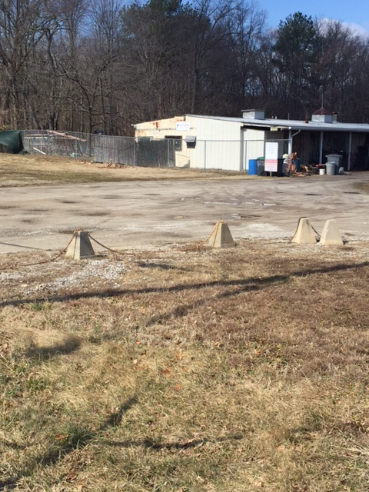
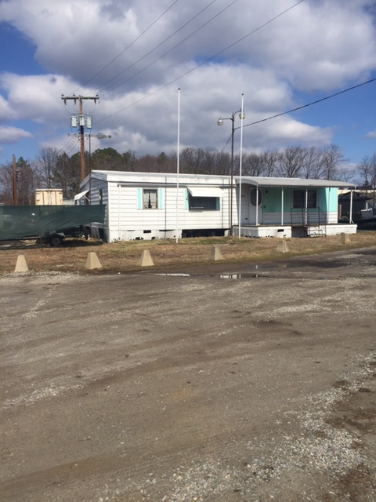
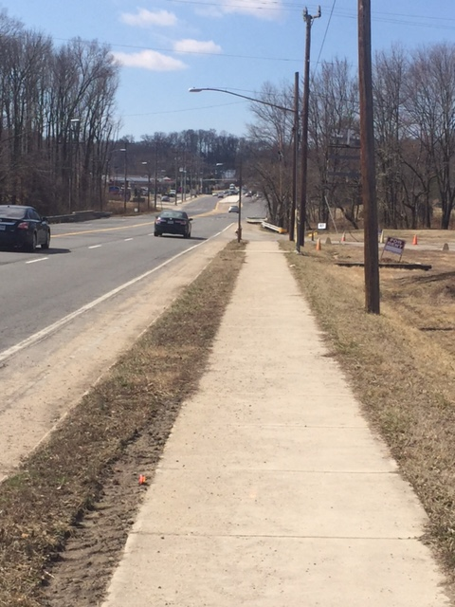
8800 site frontage….hiding an on site mess

Slide 8
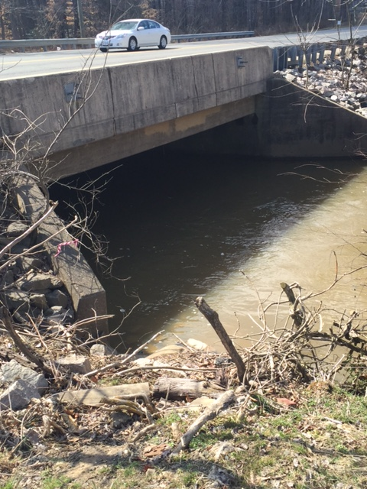
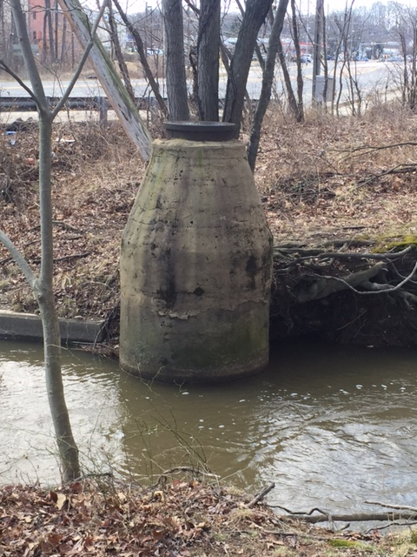
Stream Tour: adjacent stream and bridge after 4 days of rain
Bridge & sewer manhole in stream to show FP after 4 days of heavy rain note top 1’ Manhole out of 100 year FP

Slide 9
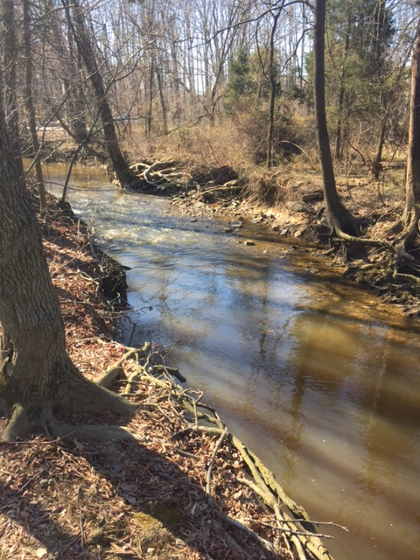
Normal flow view of stream 3/31/14 next slide high flow

Slide 10
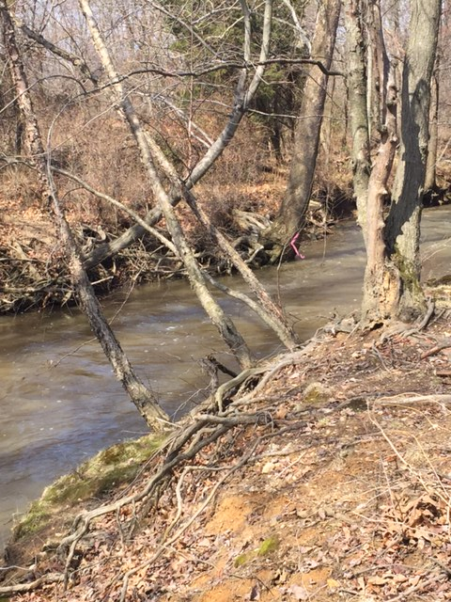
Stream Bed at southern part of the site near bridge
Note the
Channel is
Nicely
Defined,
But channel
undercut
and see after
4 days of
heavy rain

Slide 11
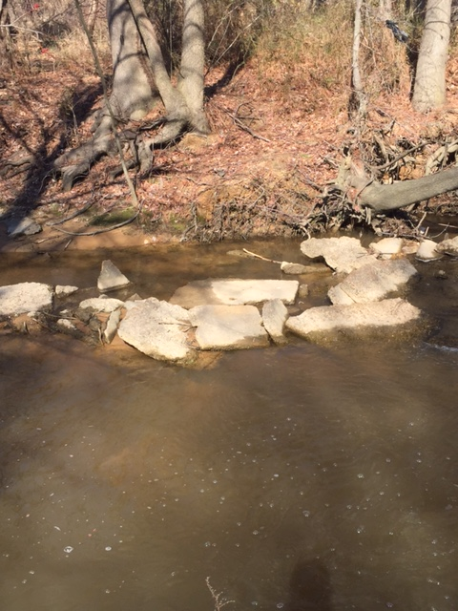
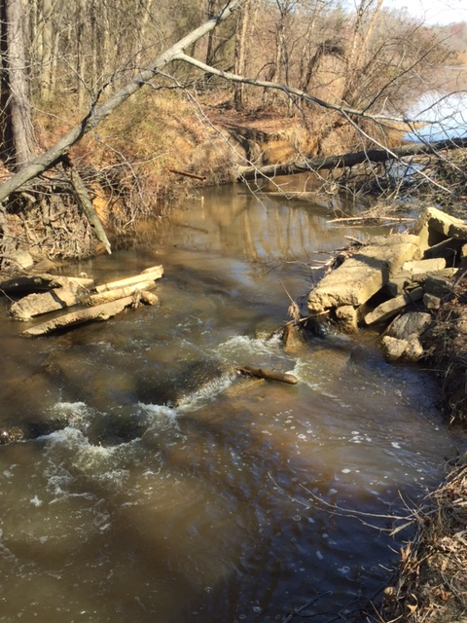
Upstream views of channel: concrete chunks from ?

Slide 12
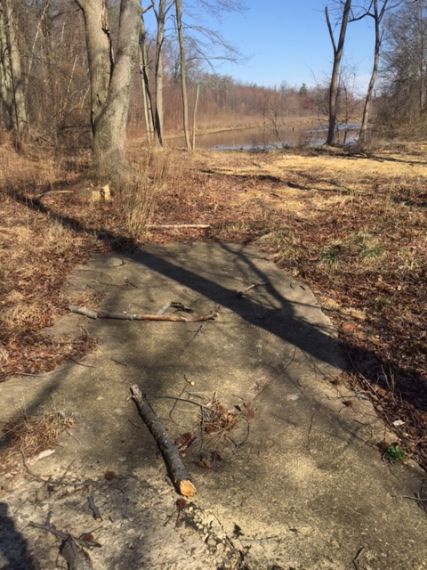
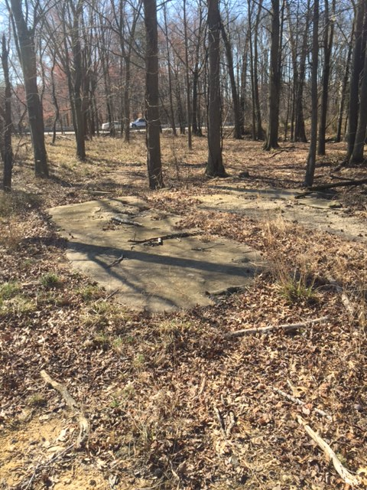
Site area adjacent to stream bed, concrete slab and remnants of old amusement park

Slide 13
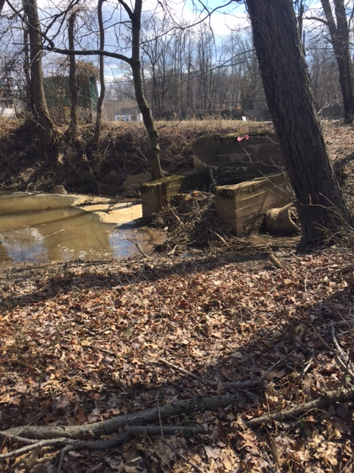
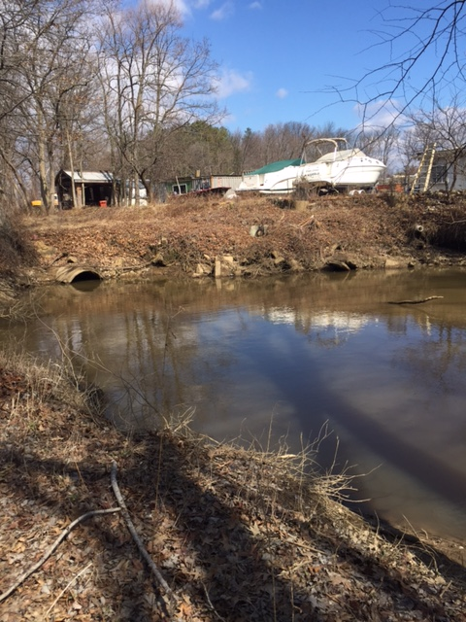
Remnant of old pond from Amusement Park and from former Beaver activity
C

Slide 14
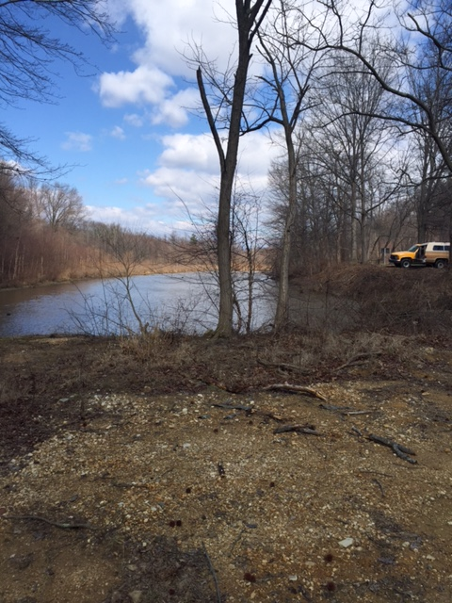
From site pond (note impervious area) looking to the Park Authority pond area to the West

Slide 15
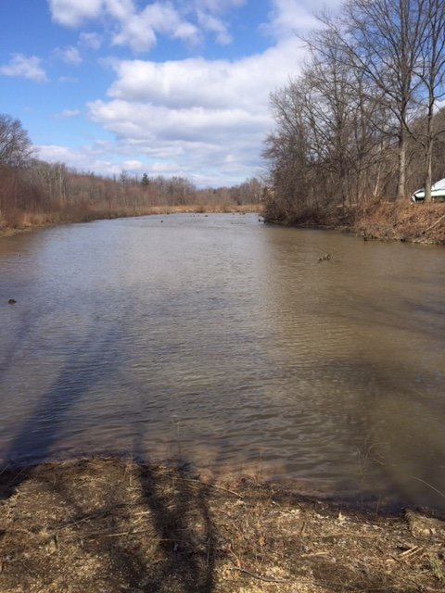
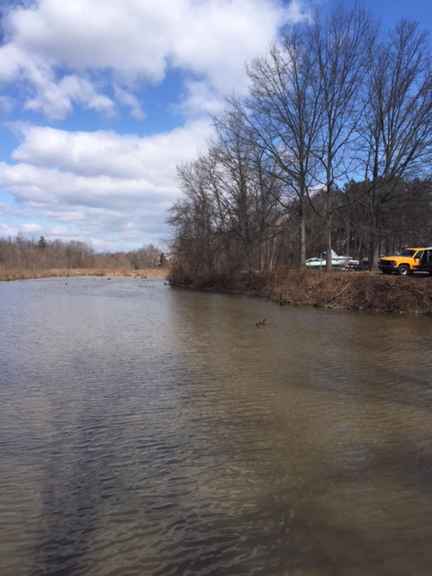
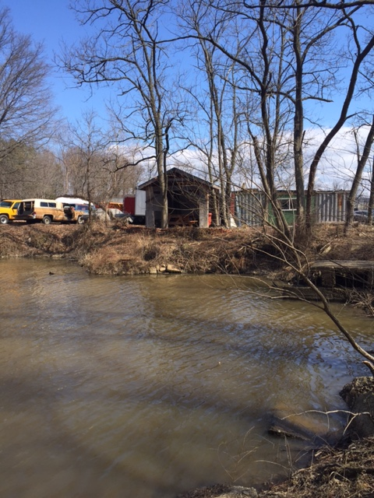
Part of the pond is within the property boundary: Also note that structures & storage is right up to the pond area

Slide 16
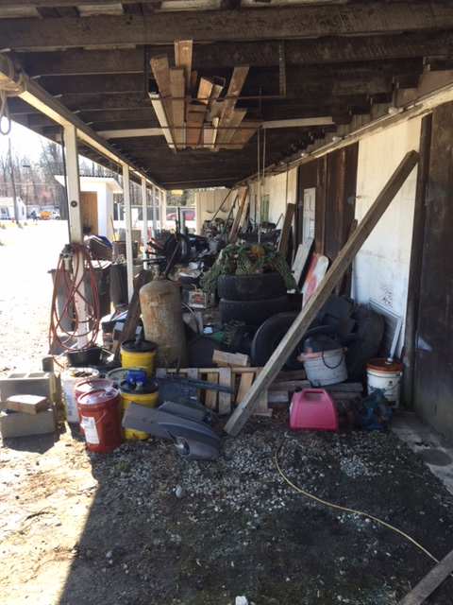
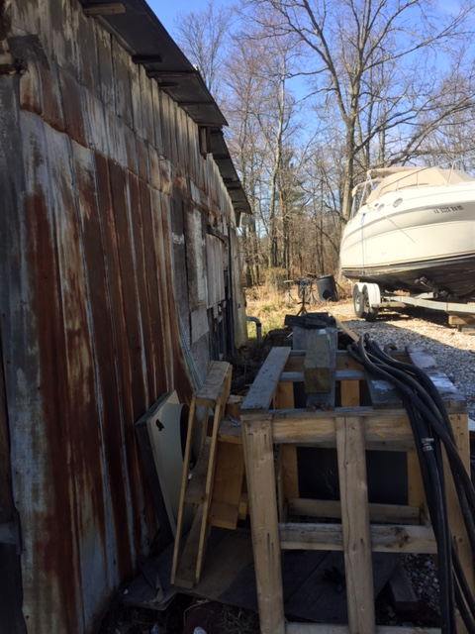
Lets look on site: it’s not a clean site and impervious both in and out of the FP

Slide 17
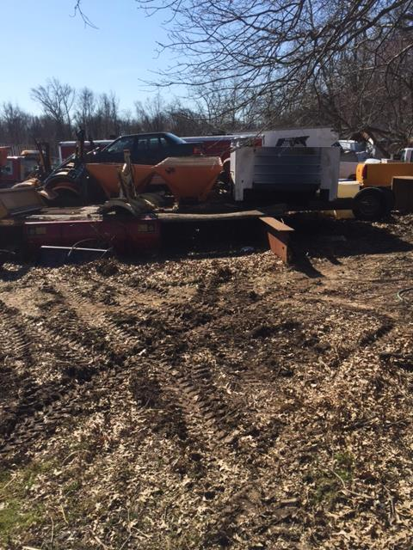
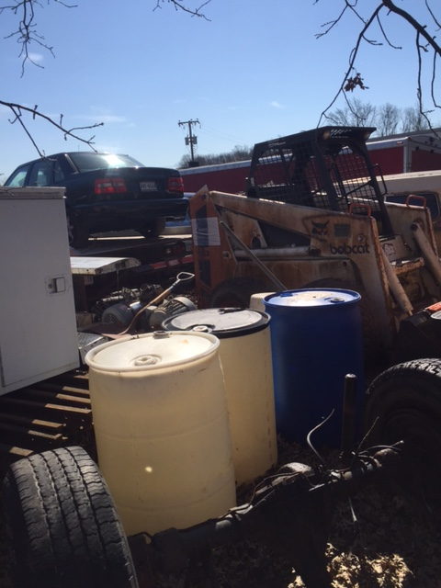
More on site environmental problems and site operations, some recently “cleaned”

Slide 18
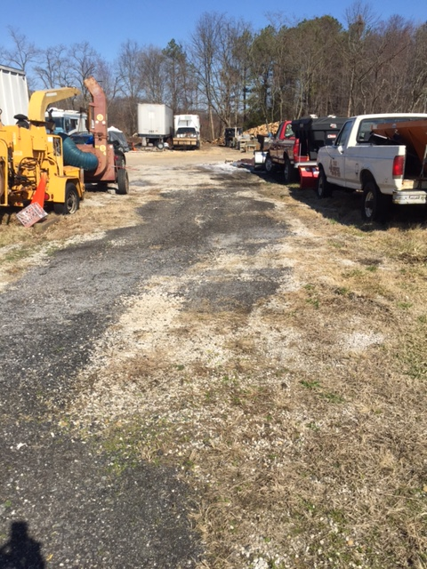
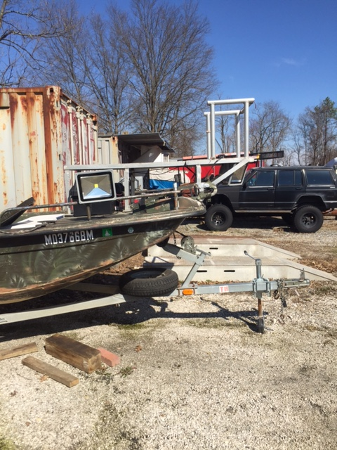
Examples of on-site imperviousness

Slide 19
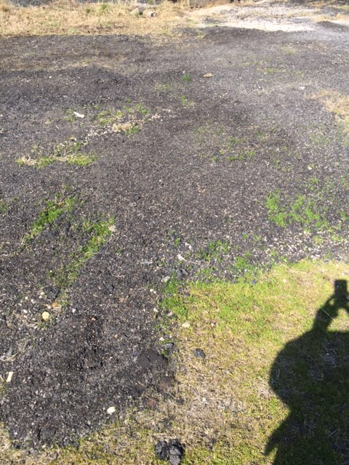
Most of the site is macadam/concrete/crushed rock

Slide 20
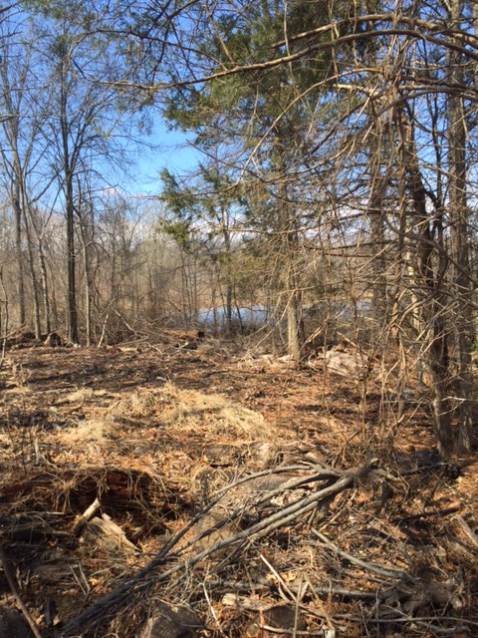
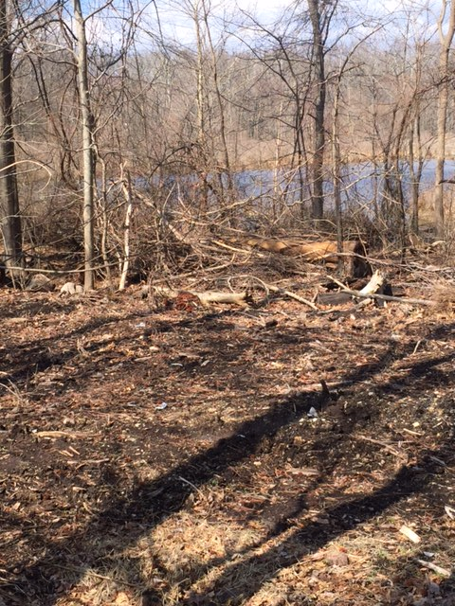
Toward the rear of the site looking south west to the Park Authority pond from logging operation on site

Slide 21
What we propose
Remove the welding shop, boat repair, on site storage of waste soil, wood chipping operation clean up the flood plain of the concrete, macadam and etc, etc, etc
Stop the site from continuing to pollute
Clean up the stream bed
Establish hard riparian buffers to the stream bed and Park Pond/Lake
Tree save and restoration
Restore the environmental integrity of the site

Slide 22
To do this
We will create a higher end market rate townhouse community—create a sense of place and connectivity
We will need to change the RPA boundary as it now covers the entire site and clearly the site is no RPA—rather a degraded environmental site
This is an 8 acre site and we propose to develop 4 or more acres which will necessitate that we fill some of the FP probably 1.5 acres
This will result in 3 up to 4 inches of FP increase up stream on the Park Authority Pond/Lake

Slide 23
Next Steps: Hope for community “buy in” and:
We finalize a development plan
Return to the 3 MVCCA committees with a Development Plan
Meet with the Engleside and other Community Associations concurrently
File a rezoning application and ask Supervisor Hyland concurrent “AKA Just in time Comp Plan Amendment” in furtherance of the MVCCA Plan amendment proposal
File for an RPA exception concurrently
File a “Fill in the FP” plan/application concurrently
PC and BOS Hearings hopefully by end of October
-----------------------------------------

Slide 24
Construction
Single point of access—right in and right out only
Upon approval of site plan “conduct site clean up, delineation of sensitive areas”
Remove all concrete footings in FP restore the FP which is now all in impervious surfaces
Do Riparian buffer/filter area along stream bed
Carry out stream bank restoration
Tree save areas and new plantings to restore where needed
Recycle any on site material that can be recycled

